Slide 1
DOCTOR APPOINTMENT BOOKING SYSTEM
Project Review-2

Slide 2
TEAM MEMBERS
2110030020-Ch.Sri Chandana
2110030032-D.Neha
2110030056-B.Akshita
2110030457-V.Charishma

Slide 3
PROJECT DESCRIPTION

Slide 4
PROBLEM STATEMENT
The management of doctor appointments and slots would become difficult for the hospital in general.
Maintaining the records will also become difficult in hospitals.
Adjusting the schedules for appointment would become difficult.
Communication between the doctor and patient would sometimes become difficult.
Receiving the test reports will also become late in physical appointment system.

Slide 5
AIM &OBJECTIVES
Aim:
The aim of this project is to develop a online doctor visit web application. This research project is aimed at computerizing all the records about patients, Hospital and doctors. The concept of report production has been computerized hence, no more delay in report generation to the hospital, patient and doctor.
Objectives:
To create web based Online Doctor Appointment management system.
To manage all patient related information.
To provide emergency information in critical situation.

Slide 6
PROPOSED ALGORITHM
The proposed project is a smart appointment booking system that provides patients or any user an easy way of booking a doctor’s appointment online. This is a web based application where the patient can book the slots according to their choice online. The task sometimes becomes very difficult for the receptionist or doctor himself in manually allotting appointments for the users as per their availability. Hence this project offers an effective solution where users can view various booking slots available and select the preferred date and time. The already booked space will be marked yellow and will not be available for anyone else for the specified time. This system also allows users to cancel their booking anytime. After the treatment of the patient, the reports will also be sent to the user through this application. And medication will also be provided for the patient in the application itself. Problems related to the health issues can also be asked by the users and proper solutions will be specified by the doctors in the application.

Slide 7
FEATURES
Features of the project:
We implement this application for better user experience. This application is very easy to access. Also for establishing real time communication, using modern and updated technology. So, user can see the update.
This application will compatible with user device such as pc, laptop, tab and smart phone. So, user can easily access the application anytime and anywhere. This application is very simple and user friendly so ,any user can use this application easily.
We also provide security so that the data is secured from dangerous activities like hacking and loss of data which is already stored.
We provide the medical test reports in the application itself so the user can easily check the reports online through the application itself.
Medication is also prescribed by the doctors in the application.

Slide 8
TOOL SETUP
Visual Studio Code is used for the front-end development .
TerraER is a simple to use application which allows you to create ER and EER diagrams in a graphic environment.
We write queries with the help of MySQL. Hence, we use it for the back-end development.
Star UML is a software used to create the data modelling diagrams like class diagram, use case diagram, sequence diagram, flow charts etc..

Slide 9
DATA MODELLING DIAGRAMS

Slide 10
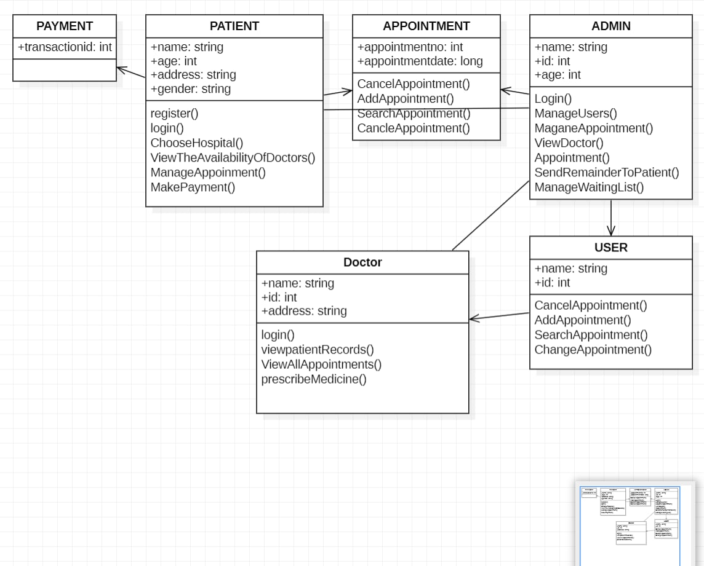
CLASS DIAGRAM

Slide 11
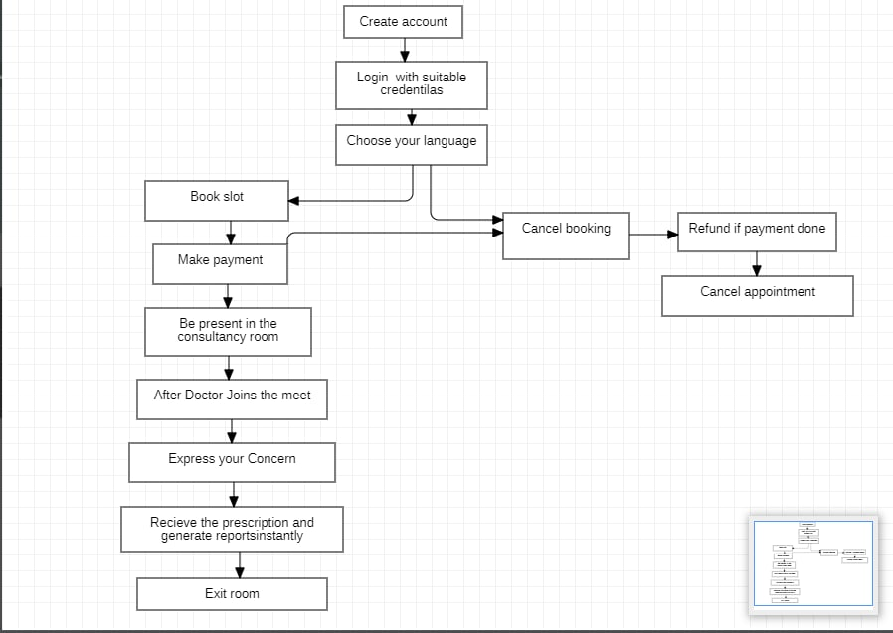
FLOW CHART

Slide 12
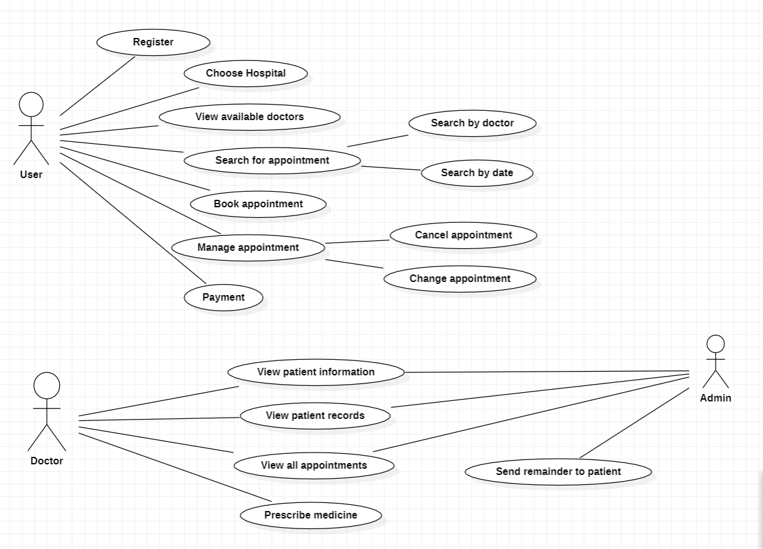
USE CASE DIAGRAM

Slide 13
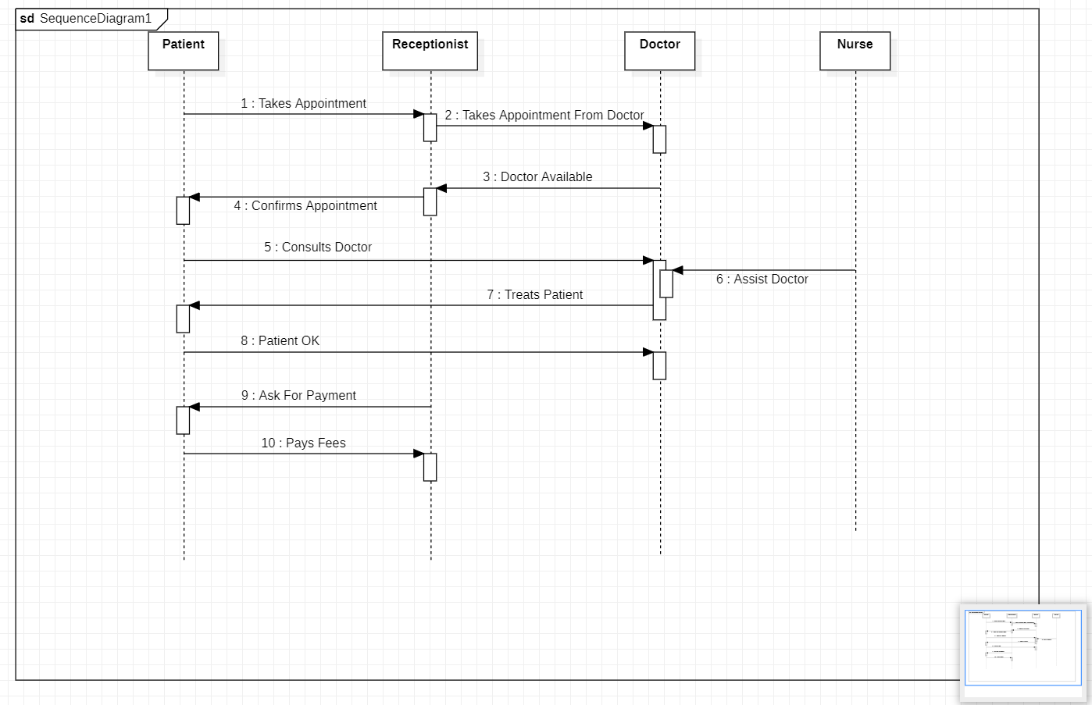
SEQUENCE DIAGRAM

Slide 14
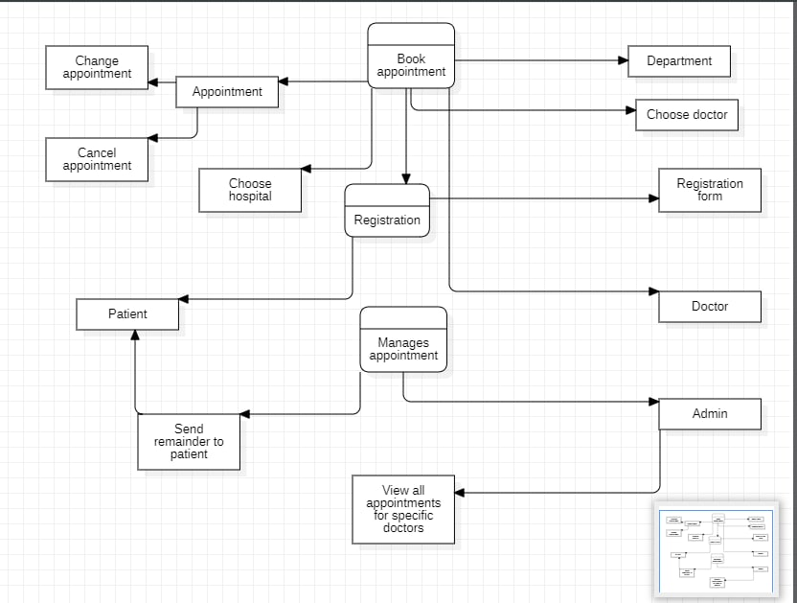
DATA FLOW DIAGRAM

Slide 15
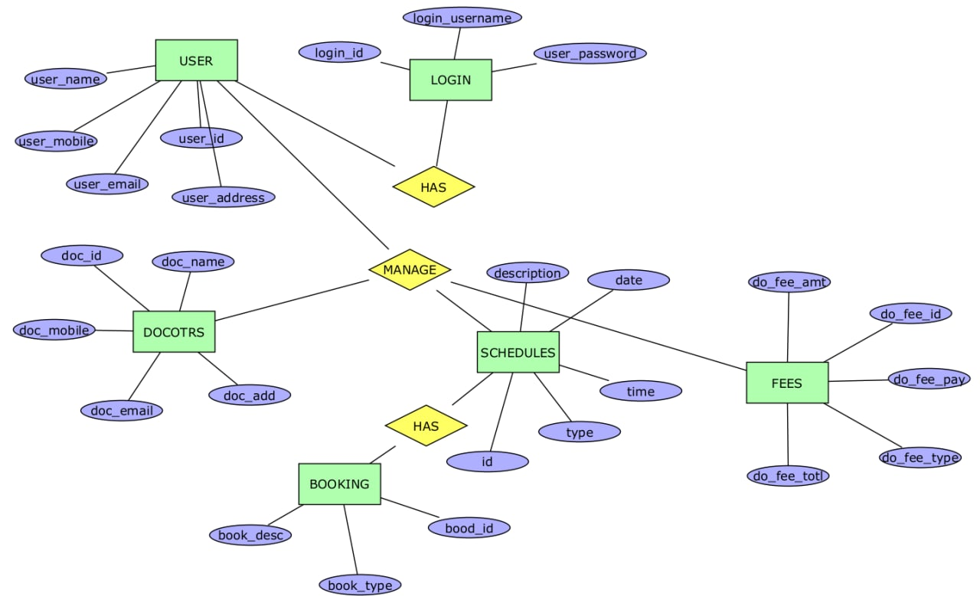
ER DIAGRAM

Slide 16
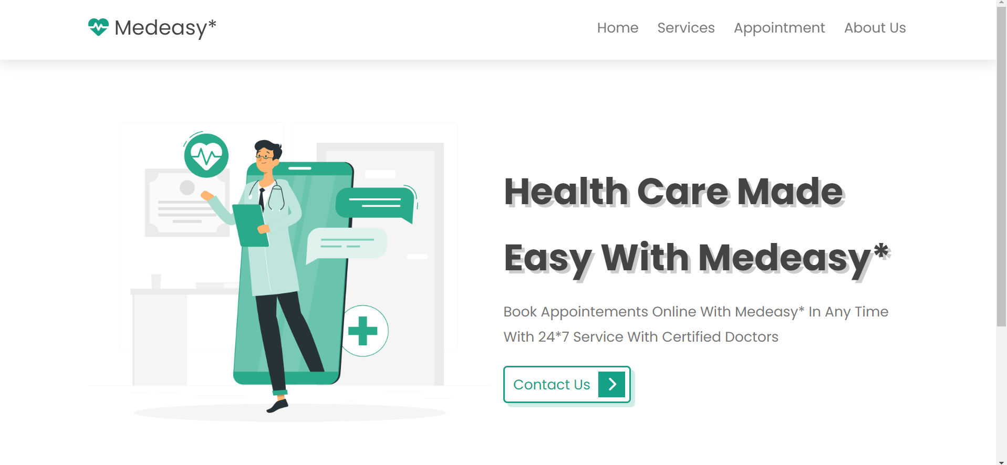
FRONTEND

Slide 17
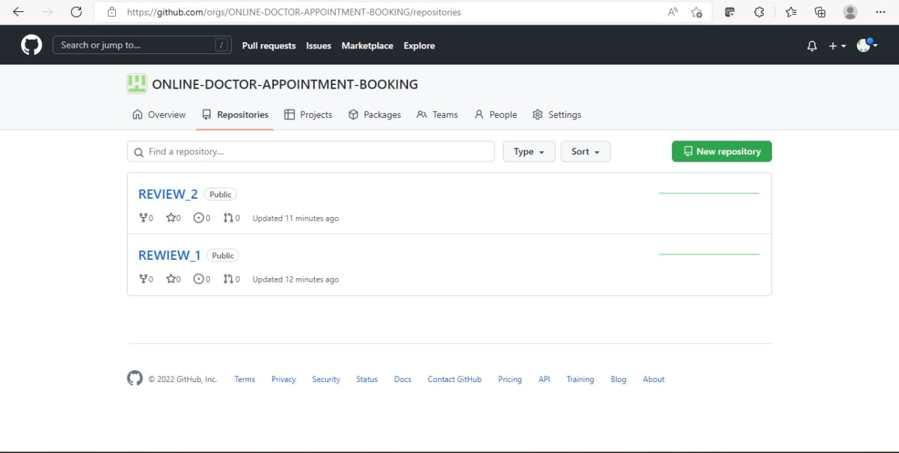
GITHUB REPOSITORY

Slide 18
Thank You

